Slide 1
Crafts portfolio
By: Ellie Dionise

Slide 2
“Bowly”
Medium: Magazine, Mod Podge
This project was hard to do because once I got the magazine all rolled up, the inside would fall out. Once it was finished and I finally got it to be in a bowl shape, I thought it was really cool and I liked how I used all the random colors.

Slide 3
“Sunset”
Medium: Paint samples
This project took a long time because I had to make the pieces into shapes that would all fit together. I really like all the bright colors I used but wish I would have made the pieces fit together a little nicer to make it look better.

Slide 4
“Flowery”
Medium: paper plate, paint
I thought this project was going to be really hard, but after practicing the brush strokes it was a lot easier. I liked the way it turned out but wish I would have chosen a more detailed design.

Slide 5
“E is for Erin”
Medium: Cardboard, paint, glue, and newspaper
I thought this project was really cool and I liked it a lot. I was originally going to put pictures on it but I wasn’t able to because I kept forgetting to bring them in. I wish I did put the pictures on it but I still like the way it turned out.

Slide 6
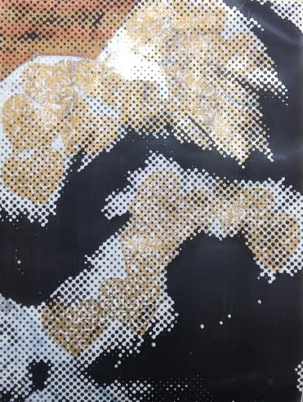
“Charlie”
Medium: mixed media
I liked the idea of using my dog for this project, but I wish I would have used different colors to make it easier to see.

Slide 7
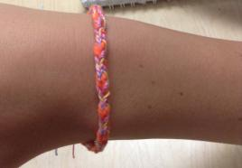
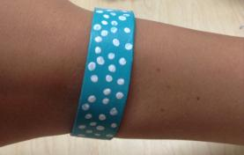
“Bracelety”
Medium: yarn, cardboard, popsicle stick, and paint
My favorite bracelet we did that was easiest for me was the one without the cardboard. I liked the colors of the other yard one the best though. The popsicle stick one was easy, but I didn’t like it as much as the yarn.

Slide 8
“George”
Medium: Felt, string, and stuffing
This was one of my favorite projects. I messed up on the sewing so I had to re sew it but I love the way it turned out. I really like how one eye is bigger than the other and his crooked smile.

Slide 9
“Rainy”
Medium: Crayons
This was another one of my favorite projects. I liked how I did half rain and half flowers and think the way I (with Erin’s help) melted it turned out really well.

Slide 10
“Masky”
Medium: Paint, paper mache
I liked my mask and the designs I used but I wish I would have pushed the paper mache in more because I kind of lost the shape of the nose and lips.

Slide 11
“E is for Ellie”
Medium: T-shirt, sharpies, bleach
This project didn’t really turn out the way I wanted it to because the bleach didn’t work on my shirt. After going over it with sharpie, I thought it looked good but still not exactly what I had in mind.

