Slide 1
Crafts & Mixed Media Art Portfolio
Quentin J. Abbott

Slide 2
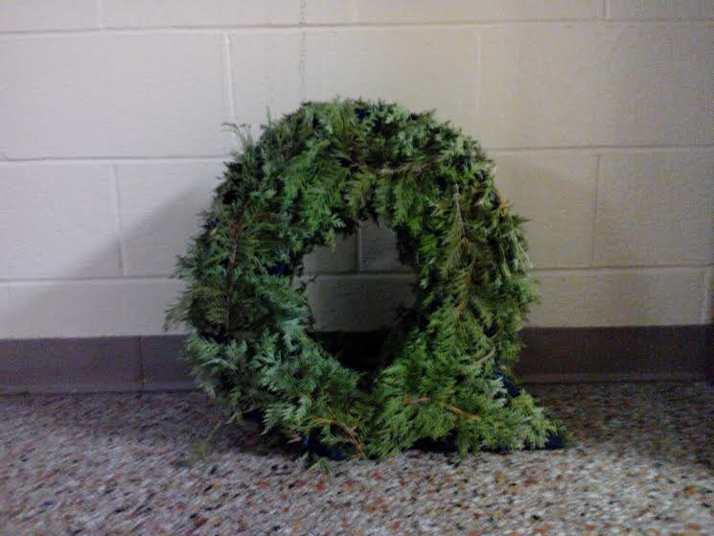
Botanical Consonant
Medium: Cardboard,
papier-mâché, hot glue, acrylic
paint, and green ferns
Description: Marriage of nature
and man’s ingenuity

Slide 3
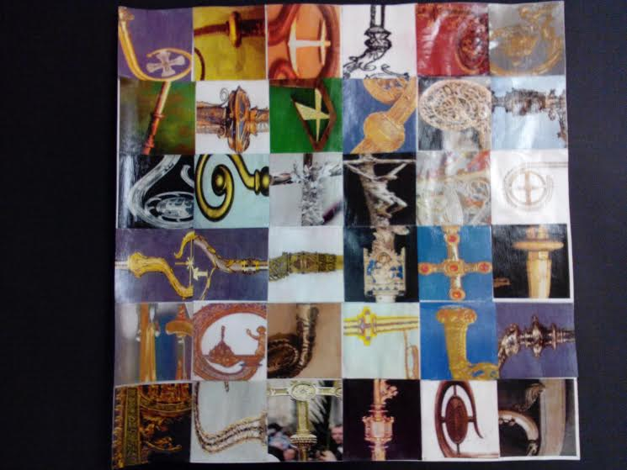
Pastoral Photomontage
Medium: Cropped images on
computer paper, white paper,
glue, and mod podge
Description: Displays the
splendor of the Episcopal ministry

Slide 4
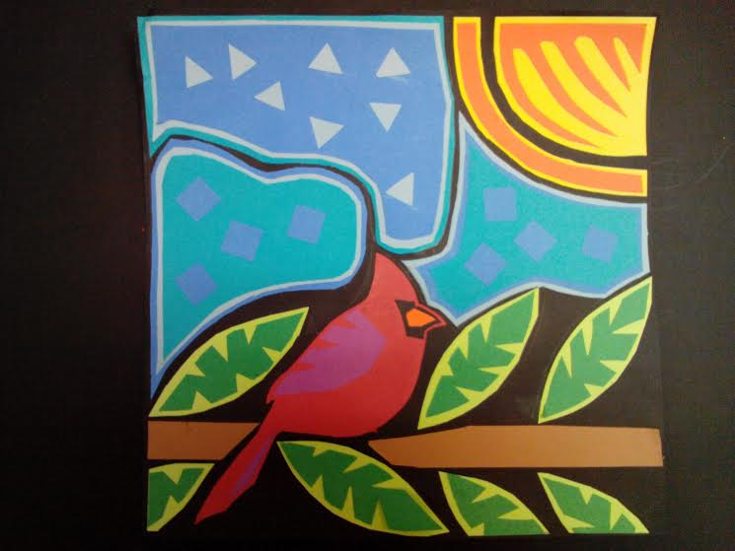
Manifold Mola
Medium: Construction paper &
glue
Description: Merits a sense of
simple elegance through a colorful
arrangement of shapes

Slide 5
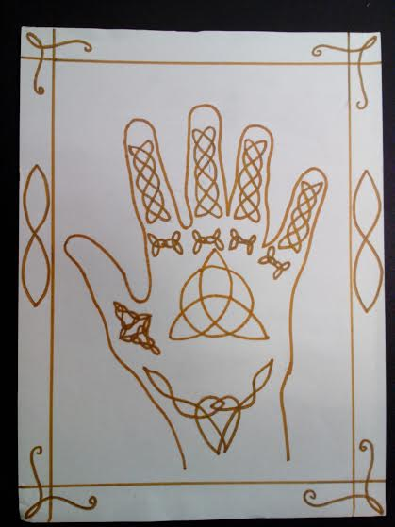
Celtic Claw
Medium: Pencil, Paper, &
Sharpie Marker
Description: Combines the
intricacy of Celtic design with a
cultural tradition of the Middle East

Slide 6
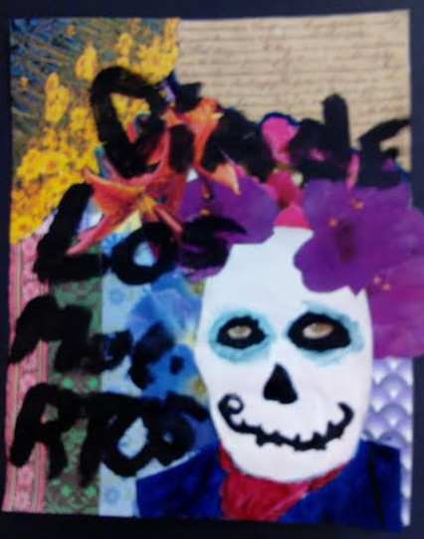
Long Live Life!
Medium: Magazine pages, glitter,
glue, paint, calligraphic writing,
& photographs
Description: Illustrates a deep,
cultural love for the gift of life

Slide 7
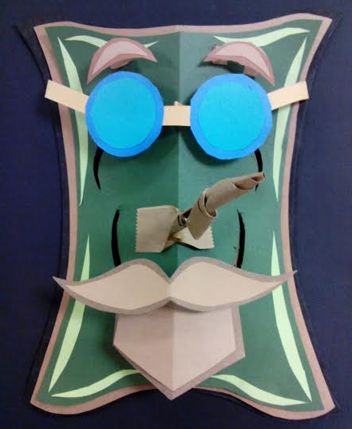
Alfred Arborson
Medium: Construction paper &
glue
Description: Revives a child’s
innocent and beautiful sense of the
surrounding world while continuing
an elaborate tradition

Slide 8
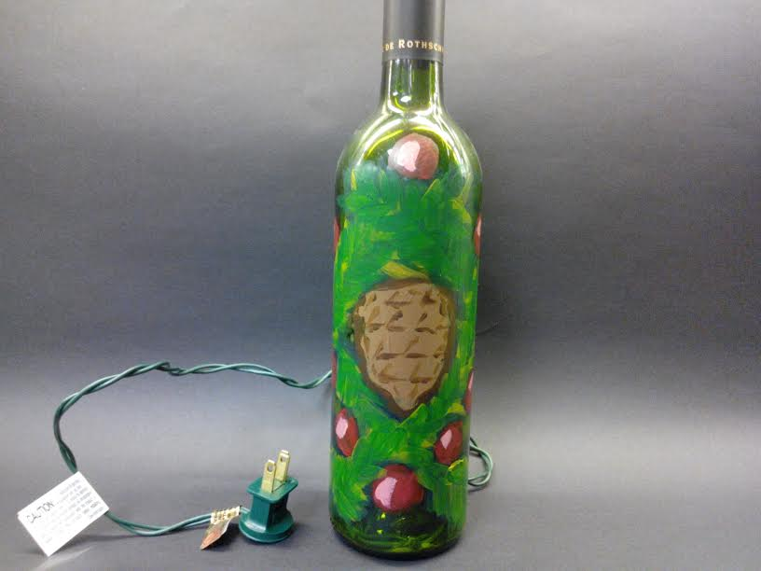
Christmas Carafe
Medium: Glass wine bottle,
acrylic paint, & tree lights
Description: Imparts a
personal sentiment for holiday
traditions

Slide 9
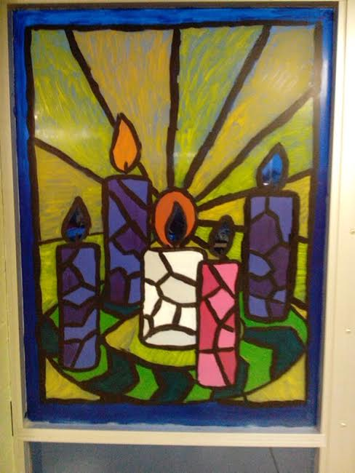
The Waiting Window
Medium: Acrylic paint
Description: Recreates a
unifying symbol of anticipation

Slide 10
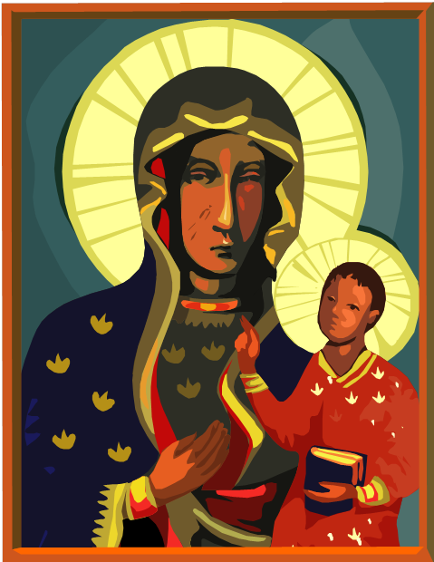
Church Folk Art
Medium: Power Point Presentation
Focus: Stressing of the beauty with
which God made man and how
that artistic property is passed onto
him.
History: Folk art has been
prevalent since the Church’s very
beginning.
Discovery: Folk art is the
integration of all the artist’s aspects
and expresses a desire to preserve a
valued tradition.

Slide 11
Conclusion
Thank you Mr. Krauss for your work in managing this class and for showing us the power and beauty of art!
Thank you for listening and the opportunity to learn along side you all!

