Slide 1
My Art portfolio
By Rachel Foy

Slide 2
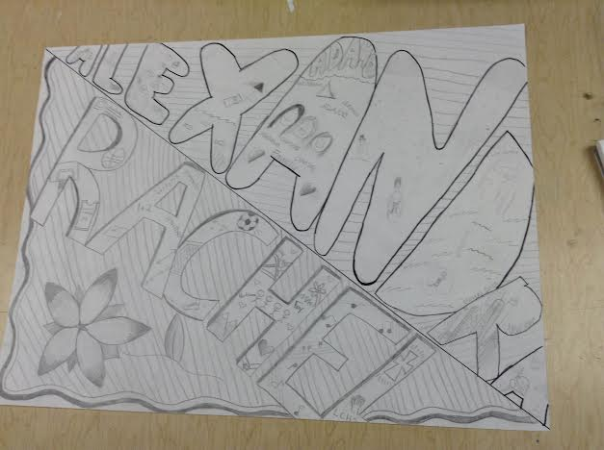
Group Project
Title: Names with Meanings
Materials Used: Pencil (Partner used Sharpie)
Description: With this project we were supposed to show our personality through our art. My partner, Alex, and I decided to put important parts of our lives within our names.

Slide 3
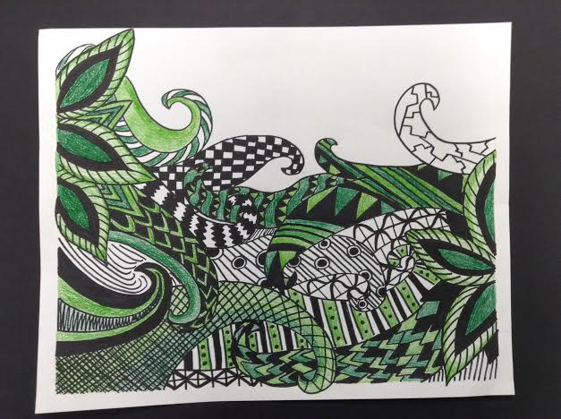
Zentangle
Title: Intertwined
Materials Used: Sharpie and Green Colored Pencils
Description: I decided to make a zentangle that looks like the vines of plants. I had two separate flowers whose vines intertwined, hence the name. I tried to put a different pattern on each vine to make the piece look more interesting.

Slide 4
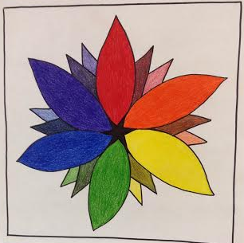
Color Wheel
Title: Rainbow Blossom
Materials Used: Sharpie and Colored Pencils
Description: In this project we were supposed to have the main colors of the color wheel along with the tinted and shaded versions of them. I put those as the smaller petals, and the main colors the larger ones.

Slide 5
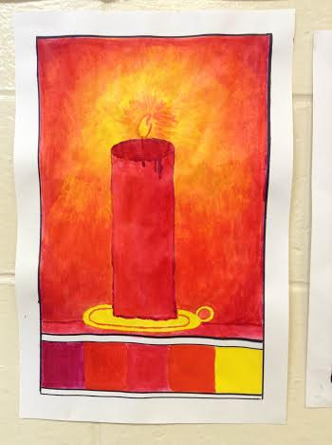
Analogous Colors
Title: Candlelight
Materials Used: Acrylic Paint and Sharpie (for the border)
Description: This is one of my favorite pieces of art. I enjoyed mixing the paints to make the glow of the candle. We were allowed to pick complimentary or analogous colors so I picked analogous. I used variations of red, orange, and yellow.

Slide 6
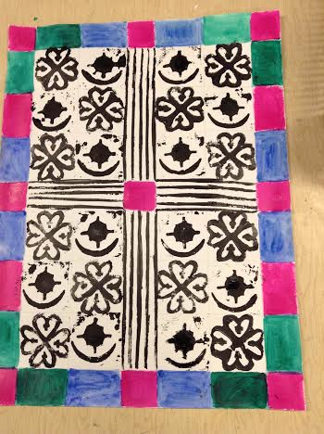
Adinkra stamp
Title: Faith and Protection
Materials Used: Linoleum Square, Acrylic Paint, Brushes, Cardboard Rectangles, and Black Ink
Description: I made this with Lexie. I made the stamp that looks like the clover. It is Nyame Dua, which means God’s protection and Lexie’s means love and protection. They both are associated with each other and that is why we picked them for this piece.

Slide 7
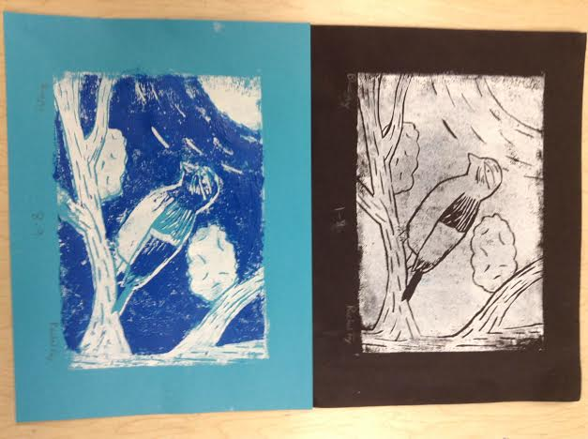
Linoleum Print making
Title: Bluejay
Materials Used: Linoleum Sheet and Ink
Description: I used light blue paper, then used white ink over it with my stamp. After that, I used dark blue ink. The top picture was one of my first prints, but I decided to give my piece a little color with shades of blue. I added texture to my piece by carving into the tree and bird to make it a little more interesting to look at.

Slide 8
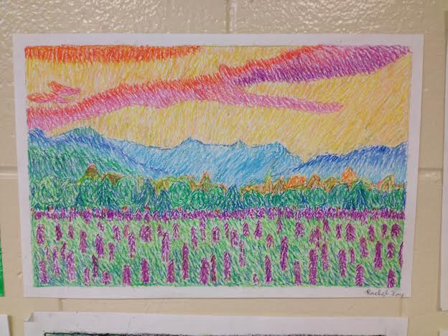
Impressionism
Title: Mountain Spring
Materials Used: Pastels
Description: I based this piece off of a picture of actual scenery in a calendar. I picked it because I thought the colors were beautiful. I focused on blending the colors with dashes rather than the actual shape of objects.

Slide 9
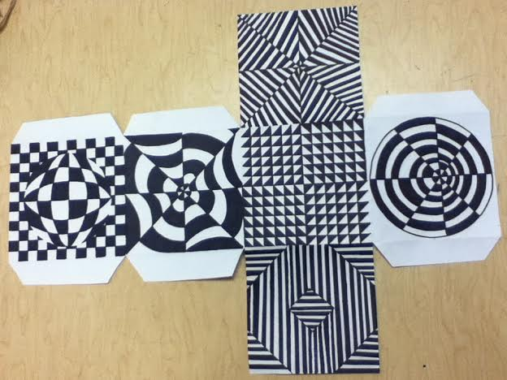
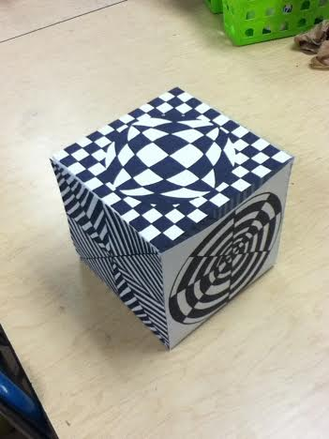
Optical Art
Title: Confused Eye
Materials Used: Sharpie, Ruler, Compass
Description: I filled each side with an optical illusion that seem to be moving or confusing to the eye. I learned that you have to be very exact for it to be affective.

Slide 10
Scratch art
Title: Baby Panda
Materials Used: Scratch Art Paper
Description: I really enjoyed this project. I decided to make a panda so that I could show the texture of it and it had the appropriate colors. I added bamboo to the background because the background was boring without it.

Slide 11
Artist Project
Title: Georgia O’Keeffe
Materials Used: Sharpie and Colored Pencils
Description: For my artist picked Georgia O’Keeffe because I thought her art was beautiful and interesting. It was hard to do abstract, but I am glad I stuck with it. My favorite piece of all of hers is the one in the bottom left side of the poster, Blue and Green Music.

Slide 12
Pencil transformation
Title: Flower and Snake
Materials Used: Sharpie and Colored Pencils
Description: I expanded, shrunk, and curved pencils to create my piece. I added shading so that the flower had more value and was more interesting to look at. I made a snake because I wanted to add to my picture and because I thought it would look cool to make the snake’s scales pencils.

Slide 13
Ceramics
Title: Clay Anime
Materials Used: Clay, water, slip, dental tools, and roller.
Description: I decided to do a manga look for my clay face. It was something new that I was not entirely comfortable with, but I am glad I tried it. I added the hair to the slab and carved in the face with the dental tools we were given. I scored the slab to make sure that the hair would stay on my piece.

