Slide 1
Drawing and Painting Portfolio
Sarah Dershem

Slide 2
Where Passions Collide: Self Portrait
Medium
Colored pencil, watercolor pencil, graphite pencil
This piece contains
a cross, flute, paint brush, flower, necklace and tree layered over a silhouette.
This project was a little difficult for me because I wasn’t sure what to include. Eventually I decided to add things that I enjoyed or things that meant something to me.

Slide 3
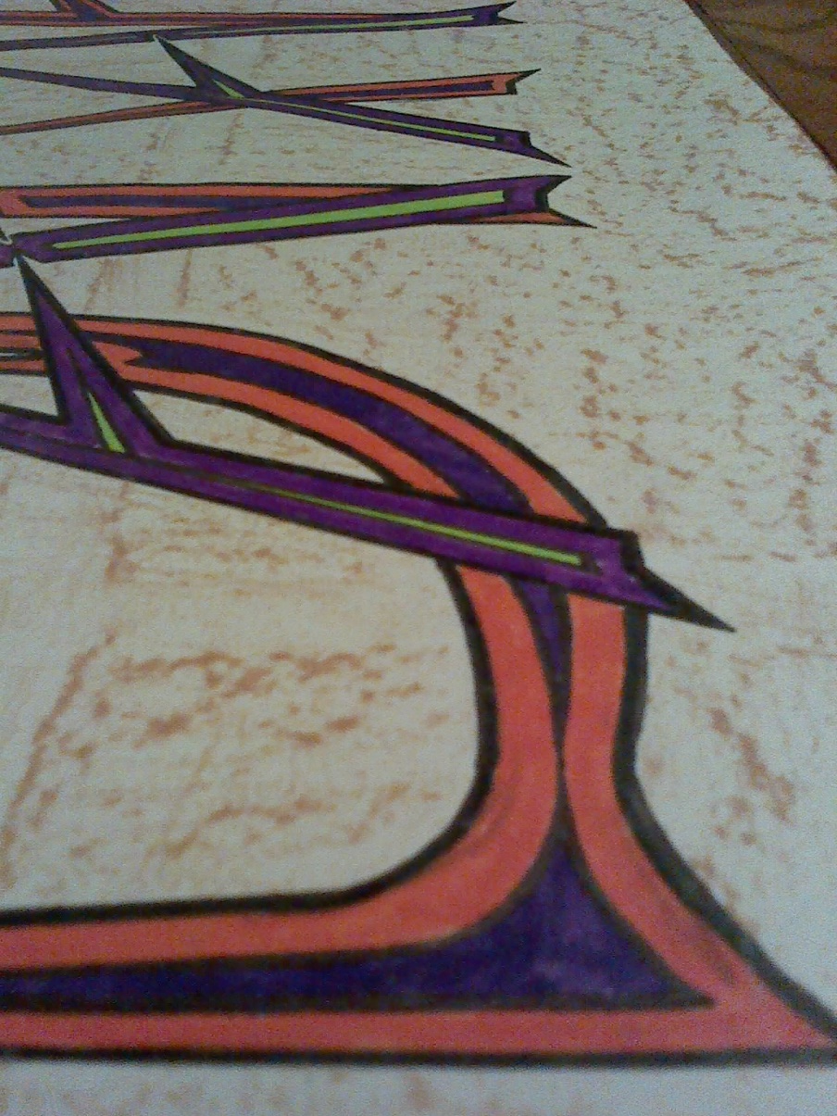
Sharp: Graffiti
Medium
Markers, sharpie, and ??
This project is my least favorite because I don’t like the colors that I chose to do the letters.

Slide 4
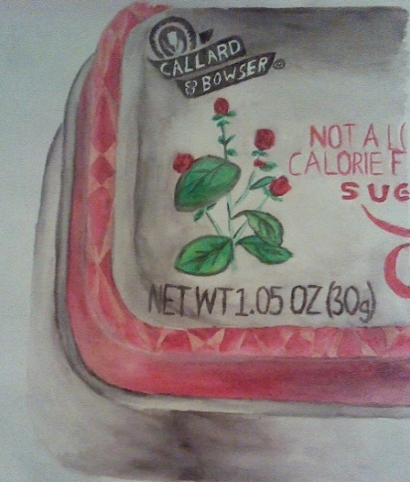
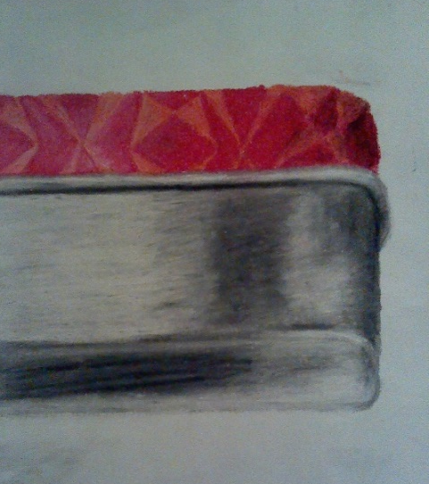
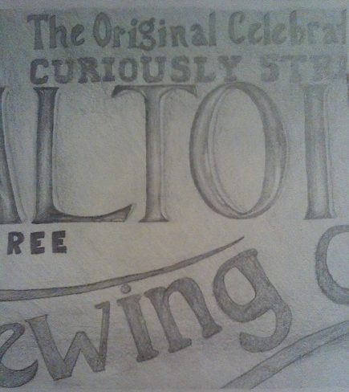
Minty Freshness: Three-Panel Still Life
Medium
Watercolor paint, oil pastel, and pencil
This project is one of my favorites because I like how it turned out and it was fun to try all the different mediums.

Slide 5
Innocent Joy: Pointillism
Medium
Markers
This project is another of my favorites because I really liked the reference picture.
What I didn’t like about this project was that making the dots was kind of tedious.

Slide 6
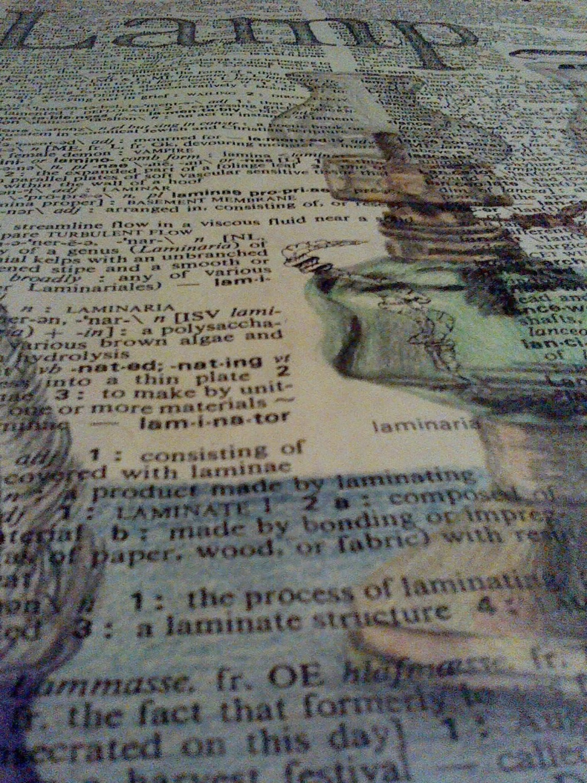
A Light to Read By: Dictionary page
Medium
Colored pencil, pencil, coffee, tea
This project was fun because of the added “aging”
I like how the green glass turned out, but I think the metals look kind of faded.

Slide 7
Shelf of Worlds: Perspective
Medium
Acrylic paint
I really enjoyed this project because paint is one of my favorite mediums.
I was excited to use my own reference picture, too.

Slide 8
“You’re not yourself when you’re hungry”: Burton Morris Style
Medium
Acrylic paint, sharpie
This project was difficult for me at first because I kept wanting to add more details.
I wish I had made this more relaxed instead of with so much symmetry.

Slide 9
Folds: Figure Drawing
Medium
Pencil
The figure drawings we did were fun but the looser style was hard to get used to.
I like how the shading turned out in this project, though I could have worked on the chair more.

